Slide 1
Unit 7-2 The Pythagorean Theorem and Its Converse
PLANE Geometry

Slide 2
Pythagorean Theorem: In a right triangle, the sum of the squares of the lengths of the legs is equal to the square of the length of the hypotenuse.
$$c$$
$$a^{2}+b^{2}=c^{2}$$
$$a$$
$$b$$

Slide 3
Example 1: Find the Missing Side.
$$x$$
$$6$$
$$15$$

Slide 4
Example 2: Find the Missing Side.
$$11$$
$$x$$
$$9$$

Slide 5
Example 3: Find the Missing Side.
$$x$$
$$10$$
$$24$$

Slide 6
Example 4: Find the Area of the Triangle.
$$12$$
$$12$$
$$20$$

Slide 7
Pythagorean Triple: A Set of Nonzero Whole Numbers, a, b, and c That Satisfy the Pythagorean Theorem
Common Triples:
3, 4, 5 | 5, 12, 13 | 7, 24, 25 | 8, 15, 17
6, 8, 10 | 10, 24, 26 | 14, 48, 50 | 16, 30, 34
9, 12, 15 | 15, 36, 39 | 21, 72, 75 | 24, 45, 51
3x, 4x, 5x | 5x, 12x, 13x | 7x, 24x, 25x | 8x, 15x, 17x

Slide 8
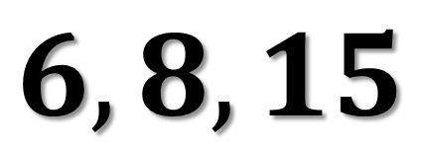
Example 5: Is the Following a Pythagorean Triple?
$$6, 8, 15$$

Slide 9
Example 6: Use a Pythagorean Triple to Find x.
$$15$$
$$x$$
$$12$$

Slide 10
Converse of the Pythagorean Theorem: If the square of the length of one side of a triangle is equal to the sum of the squares of the lengths of the other two sides, then the triangle is a right triangle.
$$a^{2}+b^{2}=c^{2}$$
$$a^{2}+b^{2}>c^{2}$$
$$a^{2}+b^{2}<c^{2}$$
Right Triangle
Acute Triangle
Obtuse Triangle

Slide 11
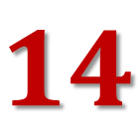
Example 7: Classify the Triangle.
$$16$$
$$7$$
$$14$$

Slide 12
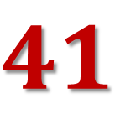
Example 8: Classify the Triangle.
$$41$$
$$9$$
$$40$$

Slide 13
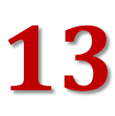
Example 9: Classify the Triangle.
$$13$$
$$9$$
$$12$$

